Slide 1
NMR Hands On
UAB Metabolomics Training Course
June 02-05, 2014
Susan Sumner, Wimal Pathmasiri, Rodney Snyder
NIH Eastern Regional Comprehensive Metabolomics Resource Core
(RTI RCMRC)

Slide 2
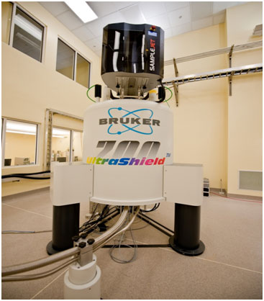
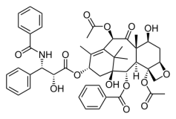
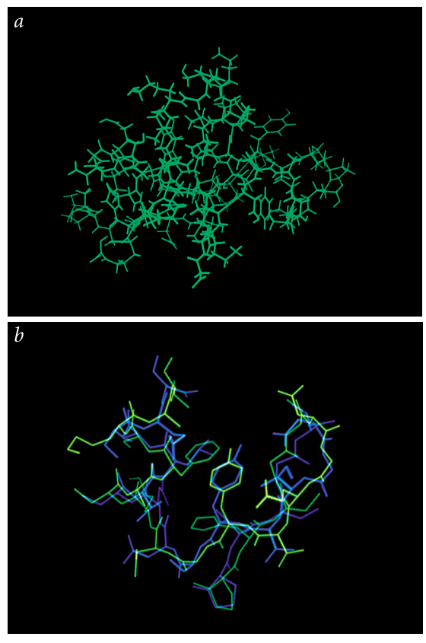
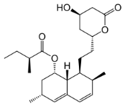
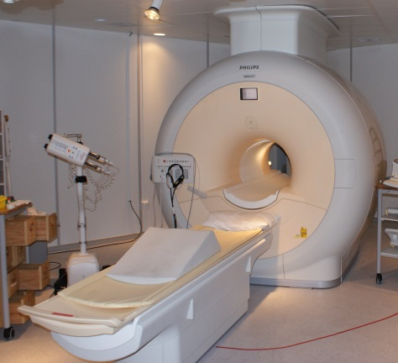
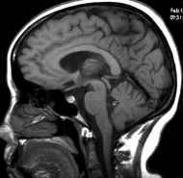
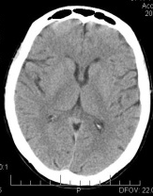
Nuclear Magnetic Resonance (NMR) Spectroscopy
Detects NMR active nuclei
Robust and highly reproducible
Non-destructive
Quantitative
Used in
  Structure elucidation
    Small molecules
    Macromolecules (DNA, RNA, Proteins)
  A number of techniques
    1D , 2D, 3D
  Molecular motion and dynamics
Similar method used in Imaging (MRI, fMRI)
Notes:
Today I am going to work with you for “Hands on NMR”. I will show you steps in recording an NMR spectrum. NMR stands for Nuclear Magnetic Resonance.

Slide 3
NMR Spectroscopy
Atom
Excitation
Emission
Notes:
In the simplest form, NMR is another spectroscopic method. An atom is in equilibrium between high and low energy states when placed in a static magnetic field. We can excite these atoms so that they move into high energy state. As usual, the atom tends to release energy.

Slide 4
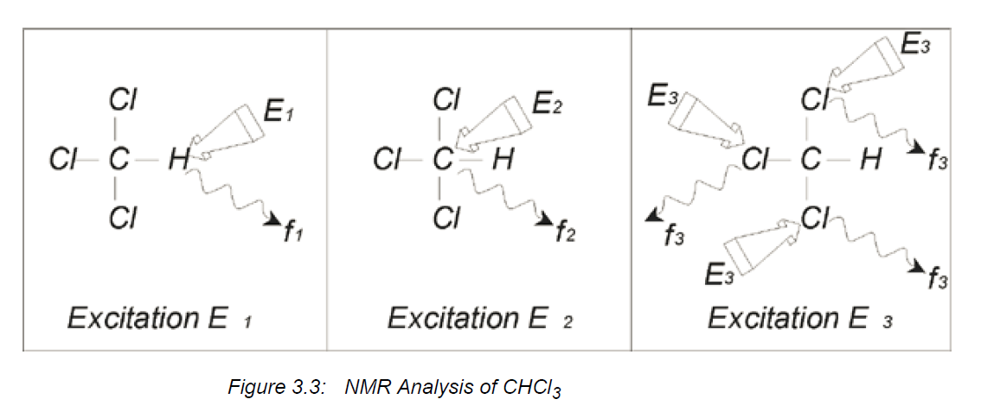
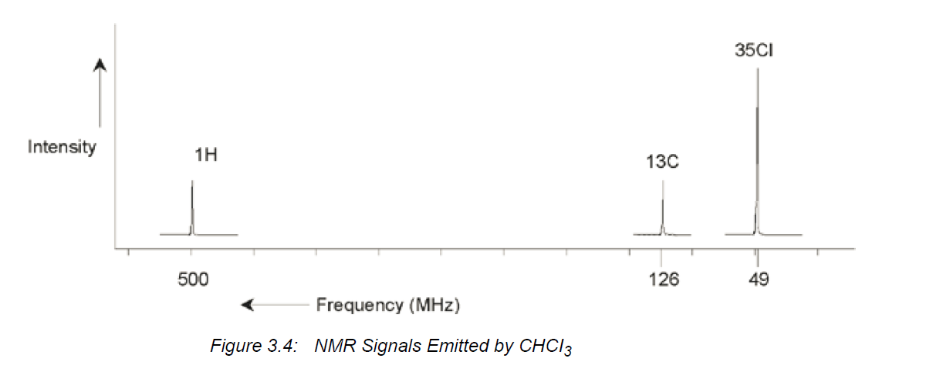
NMR Frequencies
AVANCE Beginners User Guide 004 (Bruker, Germany)

Slide 5
NMR Spectroscopy
Frequencies in 11.7T magnet
Nucleus | Basic Frequency (MHz) | Natural Abundance (%)
¹H | 500 | 100
²H | 77 | 0.015
³H | 533 | 0.005
¹³C | 126 | 1.11
³⁵Cl | 49 | 75.53
³⁷Cl | 41 | 24.47
¹⁵N | 50 | 0.37
¹⁹F | 470 | 100
³¹P | 202.5 | 100
⁵⁷Fe | 16.25 | 2.20
AVANCE Beginners User Guide 004 (Bruker, Germany)
NMR Spectroscopy Explained : Simplified Theory, Applications and Examples for Organic Chemistry and Structural Biology: Neil E Jacobsen, John Wiley & Sons, Inc. 2007, ISBN 978-0-471-73096-5

Slide 6
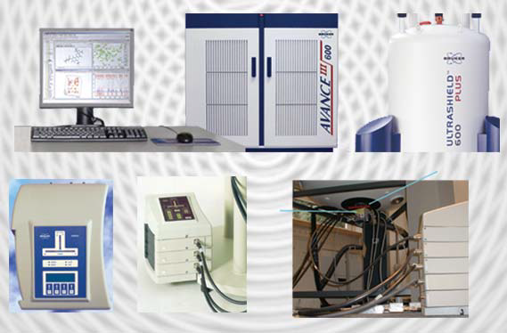
NMR Spectrometer
NMR Console
Computer
Magnet
Pre-amplifier
Probe and shim system
AVANCE Beginners User Guide 004 (Bruker, Germany)
Notes:
These are the basic components of the modern NMR Spectrometer. It consists of a superconducting magnet, NMR Console, probe & shim system, and pre-amplifiers.

Slide 7
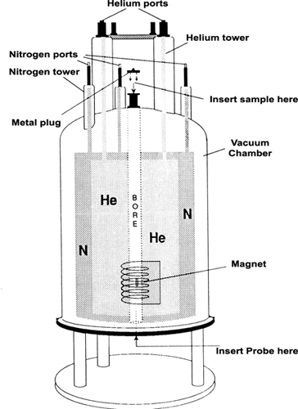
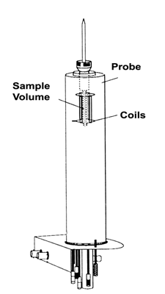
NMR Magnet and the probe
Sample is positioned on the probe using a spinner.
AVANCE Beginners User Guide 004 (Bruker, Germany)
Notes:
Left hand side shows the inside of the magnet dewar. The magnetic coil is covered with liquid helium (4 K). There is a outer jacket of liquid nitrogen to cool the system to minimize evaporation of liquid helium. The right hand side shows how the sample is positioned in the probe. The sample is inserted via a cushion of air.

Slide 8
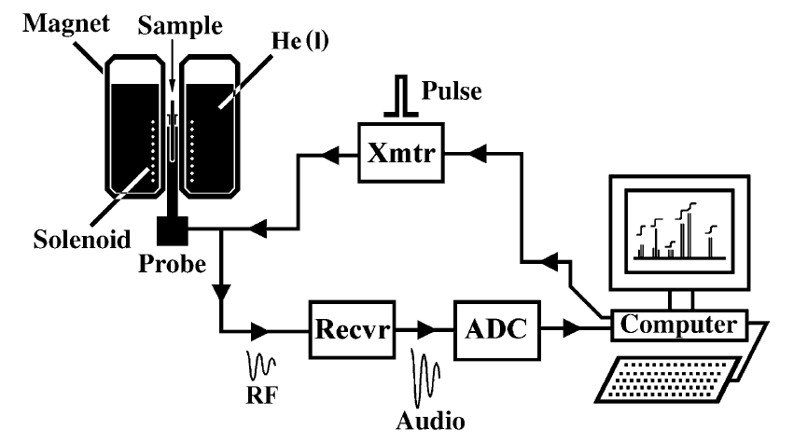
NMR Experiment
Notes:
In the NMR spectrometer, a radio signal is transmitted into the sample as a pulse and the nuclei are exited into high energy state. A signal in the receiver coil is generated. The nuclei in the high energy state comes back to low energy state. So, a receiver in the probe detects this as a decaying of a signal (Free Induction Decay).

Slide 9
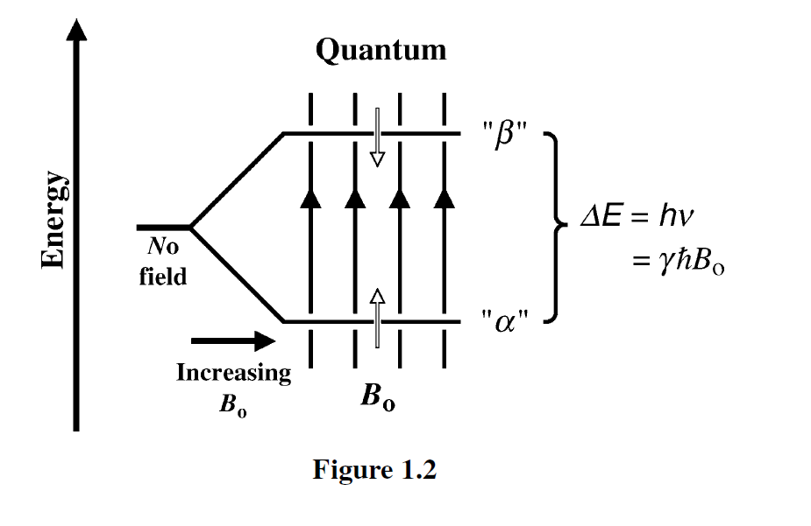
NMR Spectroscopy
AVANCE Beginners User Guide 004 (Bruker, Germany)
Notes:
The energy difference between the low and high energy state is proportional to the field strength.

Slide 10
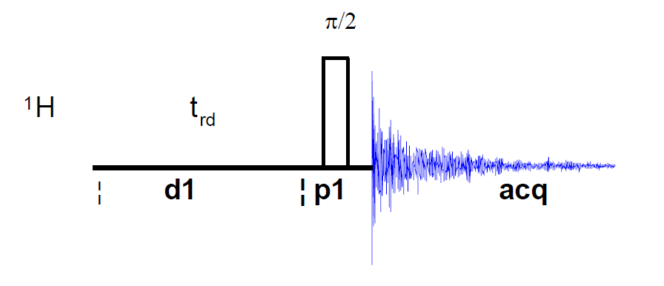
Basic ¹H Experiment
d1 = delay
p1 = pulse width
acq = acquisition time
AVANCE Beginners User Guide 004 (Bruker, Germany)
Notes:
This is a typical pulse program for a 1D 1H NMR experiment. There are many new programs developed to date.

Slide 11
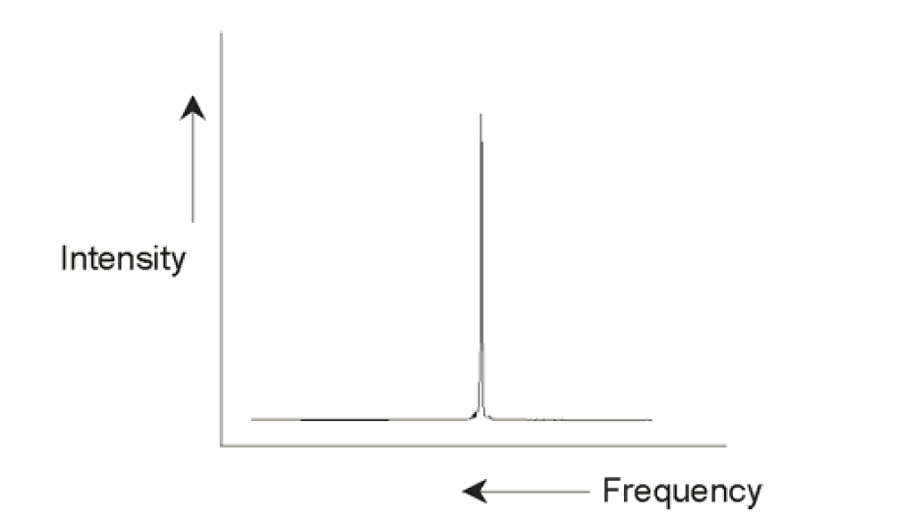
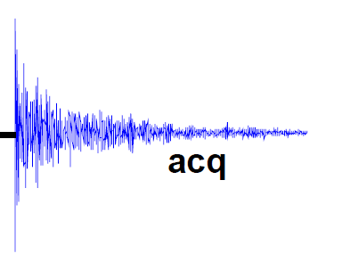
NMR Signal
Fourier
Transform
Chemical shift (ppm scale) = frequency / Spectrometer Frequency (MHz)
AVANCE Beginners User Guide 004 (Bruker, Germany)
Notes:
The FID (a time domain signal) is transformed into a frequency domain. The signal has position (chemical shift) and an intensity (proportional to the number of protons underlying). A reference compound (such as DSS, TMS, TSP) is used to reference the NMR signals and other signals are measured with respect to this signal.

Slide 12
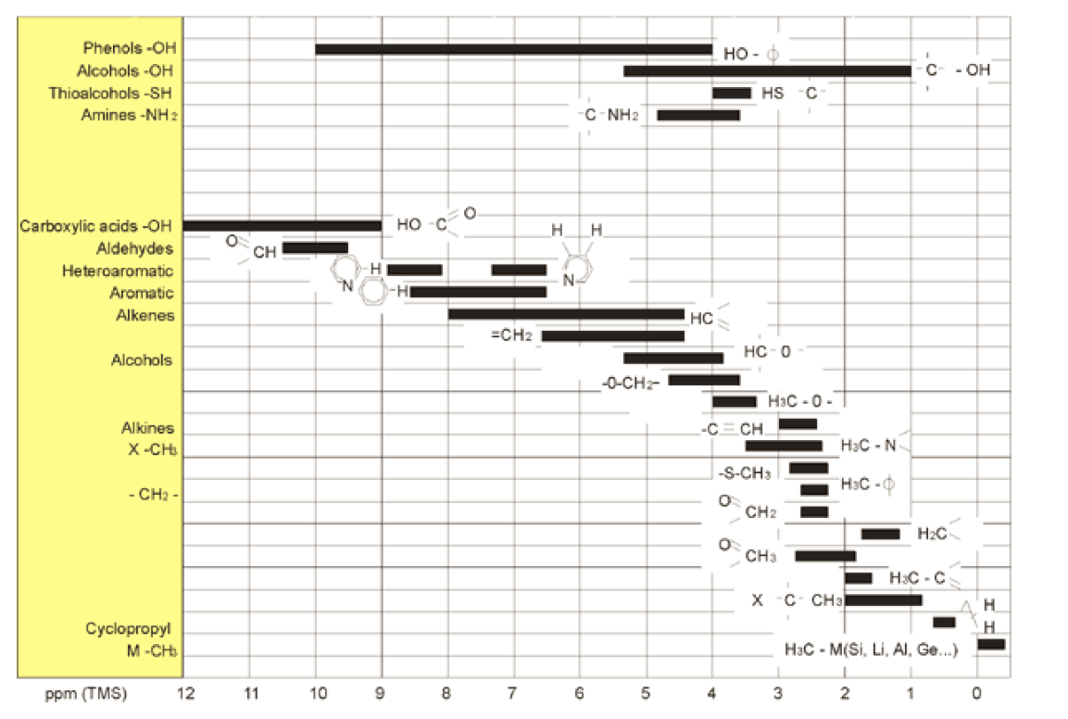
Chemical Shift of molecules
NMR Spectroscopy Explained : Simplified Theory, Applications and Examples for Organic Chemistry and Structural Biology: Neil E Jacobsen, John Wiley & Sons, Inc. 2007, ISBN 978-0-471-73096-5
Notes:
Different protons within the molecule experiences difference microenvironments (such as the effects of electrons surrounding the atom). So, atoms attached to different functional groups have different chemical shifts in NMR spectrum. This shows the chemical shifts of protons in a variety of chemical classes.

Slide 13
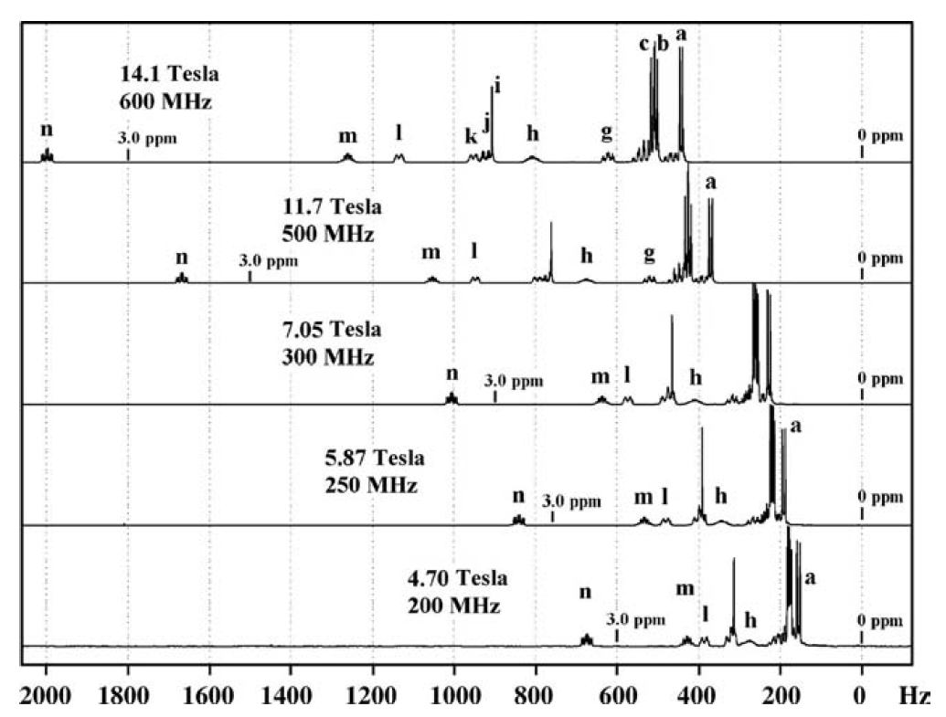
Static Magnetic field strengths
NMR Spectroscopy Explained : Simplified Theory, Applications and Examples for Organic Chemistry and Structural Biology: Neil E Jacobsen, John Wiley & Sons, Inc. 2007, ISBN 978-0-471-73096-5

Slide 14
Sample Preparation for metabolomics
Balance and calibration check
Prepare samples on ice, Minimize freeze thaw cycles
Dilution
  Using D₂O or Buffer (0.2M Phosphate)
Extraction
  MeOH or MeOH/ Water
  MeOH/ CHCl₃/ H₂O (Folch Method)
  50% Acetonitrile in Water
  Dry the sample
  Reconstitute in D₂O or 0.2M Phosphate Buffer
Internal standards
  Chemical shift reference (DSS, also for line shape)
  pH reference (Imidazole)
Pooled QC Samples
Consistency across the whole study is very important

Slide 15
Sample Preparation for metabolomics
Current sample preparation practices (in brief)
Biofluids
  Dilute with D₂O/ buffer/ 0.9% Saline
  Add Chenomx internal standard (ISTD) solution or formate (for serum)
  Centrifuge and transfer an aliquot into NMR tube
Serum, Tissue and Cells
  Homogenization performed in ice cold 50/50 acetonitrile/water
  Supernatant dried down (lyophilized)
  Reconstituted in D₂O and Chenomx ISTD solution
Pooled QC Samples (Sample Unlimited)
  Mix equal volume of study samples to get pooled QC samples
  10% QC samples bracketed
Pooled QC Samples (Sample Limited)
  Use independent pool of similar samples
  10% QC samples bracketed

Slide 16
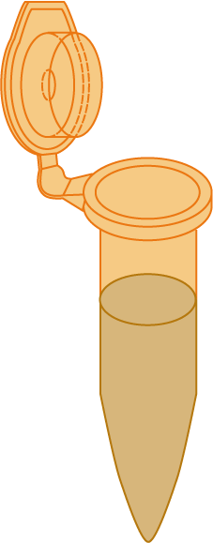
Pooled QC Samples
Aliquots from each sample in the study phenotype are pooled (phenotypic pool)
Equal amount of each phenotypic pools are pooled (Combined phenotypic pool)
Replicates of pools are prepared
Pool samples are prepared along with the study samples
Phenotype 1
Phenotype 2
Equal amounts
Phenotype 1
Pool QC
t2
Phenotype 1
Pool QC
Phenotype 2
Pool QC
Combined
Phenotypes
Pool QC
Phenotype 2
Pool QC
t1
Combined
Phenotypes
Pool QC
Pooled samples should cluster tightly

Slide 17
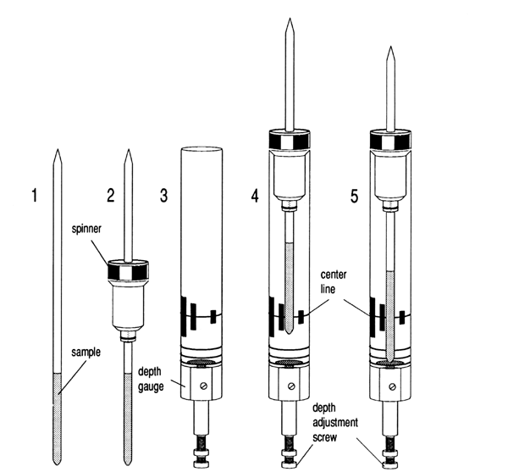
Sample Preparation for metabolomics
At least 10% D₂O in the sample
Optimum volume
  550 – 600 uL (5mm tube)
  200 uL (3 mm tube)
  Sample gauge is used
AVANCE Beginners User Guide 004 (Bruker, Germany)

Slide 18
Steps in Data Acquisition
Place the sample in the spinner
  Use sample gauge
Tune and match the probe
  Automatic in new instruments
Lock and shim the instrument
  Gradient shimming
Create and set up NMR parameters
Acquire data
Process the NMR spectrum

